Slide 1
Audio Books Everything you need to know
Robin Sullivan
Write2Publish Meetup Group
11/01/2017

Slide 2
Who am I and how to reach me
Business Manager for Author Michael J. Sullivan
9 years in the publishing business
Self-publishing, small-press, big-five
First Business of Writing Seminar in Feb 2008
Small press publisher for 4 years
Michael.Sullivan.dc@gmail.com

Slide 3
A bit about Michael and his career
Author 30 books: 12 published, 5 pending release, 13 unpublished, working on new trilogy
Riyria Revelations (6), Riyria Chronicles (4), Hollow World, The First Empire (6), Bridge Books (3)
1,180,000 English Language Books Sold
70+ Foreign Language Contracts
Self, small-press, and big-five (3 contracts)
More than 200 best-of or most-anticipated lists
5-time Goodreads Choice Nominee
Presenter at Writer’s Digest Annual Conference
Online courses with Writer’s Digest

Slide 4
History of Audio books
1930’s: spoken word albums & recordings for the blind
1948: Recording for the Blind & Dyslexic (RFBD)
1952: Caedmon Records first to sell spoken recordings
1955: Listening Library: schools, libraries, VA hospitals
1970’s: Introduction of cassette tapes (Walkman, cars)
1975: Books on Tape (later acquired by Random House)
1978: Recorded Books founded (big library presence)
1984: Brilliance doubled data (later acquired by Amazon)
1986: Turning point in the industry (Formation of APA, recognized by Publisher’s Weekly)
1997: Audible
2003: Audible & Apple distribution agreement
2011: ACX launched
2015: Fastest Growing Segment of Publishing (WSJ article)

Slide 5
Major Influencers in the Industry
Audio Publishers Association
Founded in May 1986
1994 term “audio book” became a standard
1996 first Audie Award: Oscars of the audiobook
AudioFile Magazine
First published in 1992
Published 6 times a year
Earphones Award

Slide 6
Size of the Market
1986: 9 publishers (5 major)
1985: 21 publishers (Publisher’s Weekly)
1988: 40 publishers
Lots of Consolidation going (similar to print: big 6 >> big 5)
Amazon: ACX & Brilliance
Recorded Books: Audiobooks.com | Tantor Media | HighBridge Audio

Slide 7
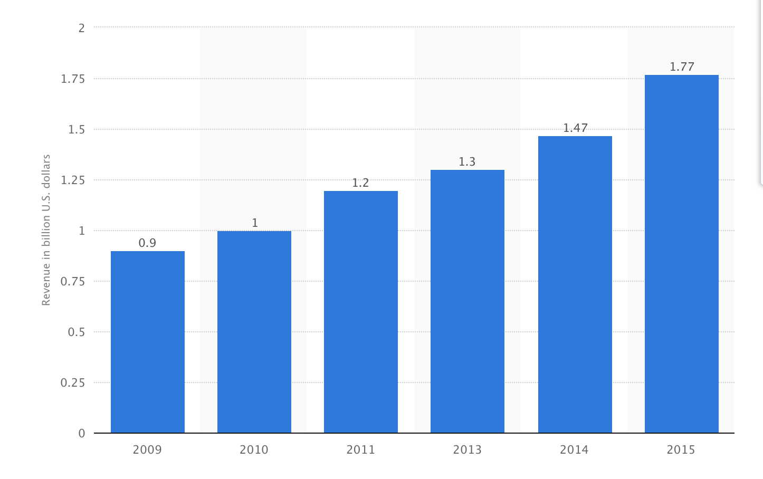
Size of the Market
2.6 Billion – most recent number I can find
2014 – 2015 growth
+38% audio
+8% hard cover
+3% paperback
-11% ebooks
2 billion hours in 2015 (2x 2014)
Titles: 2015: 35,574 | 2014: 7,237
81 million units (AAP – 3% of market)
Voracious readers: 40% more books

Slide 8
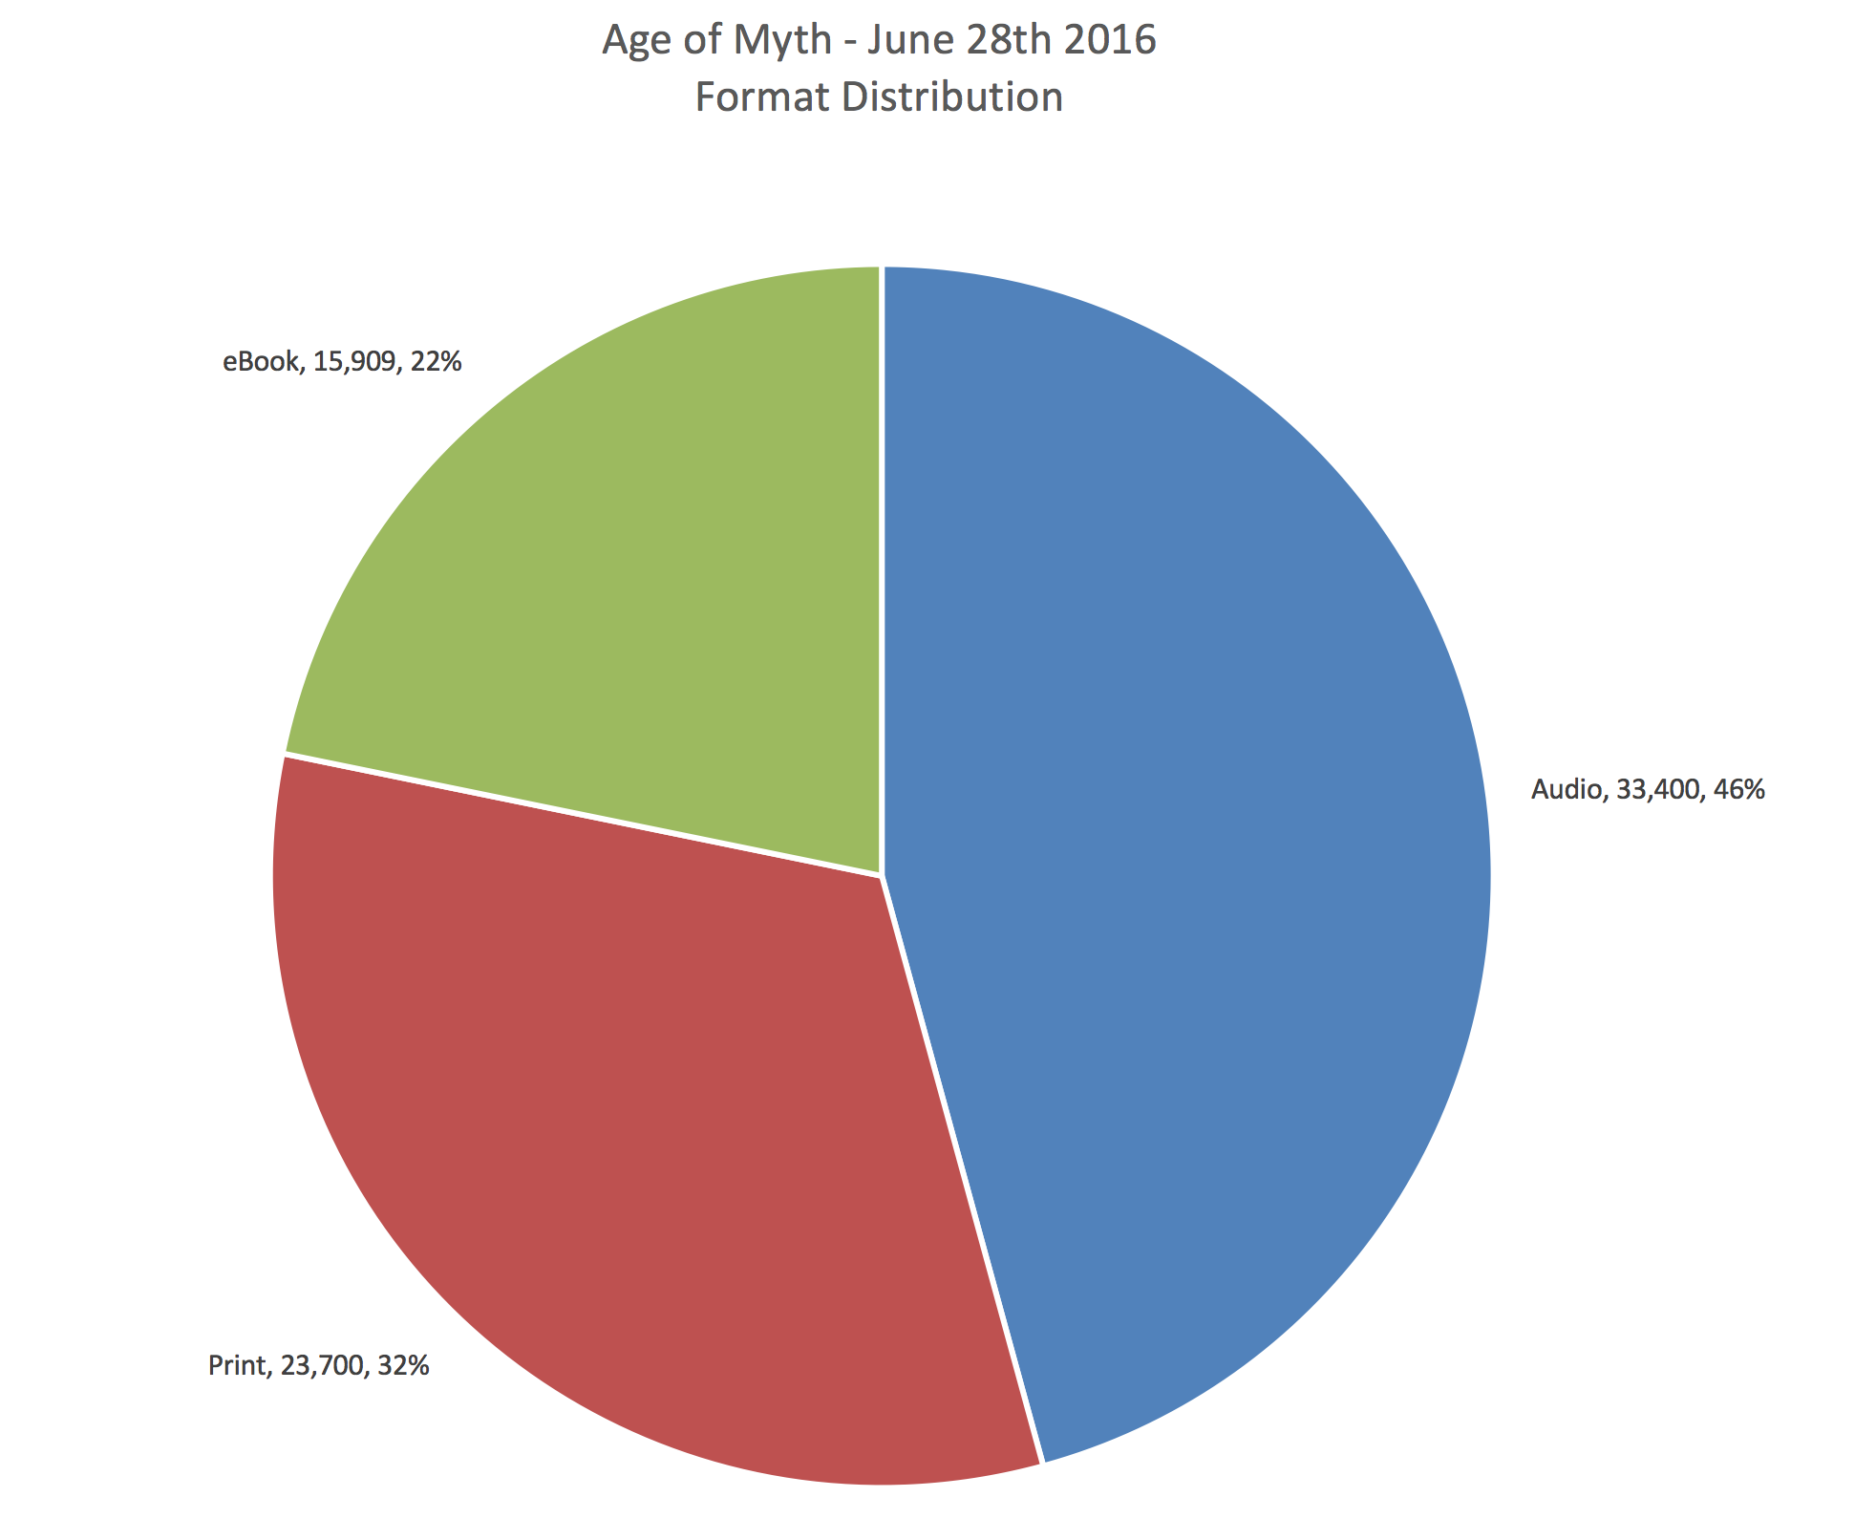
Formats: Traditional
73,000 units

Slide 9
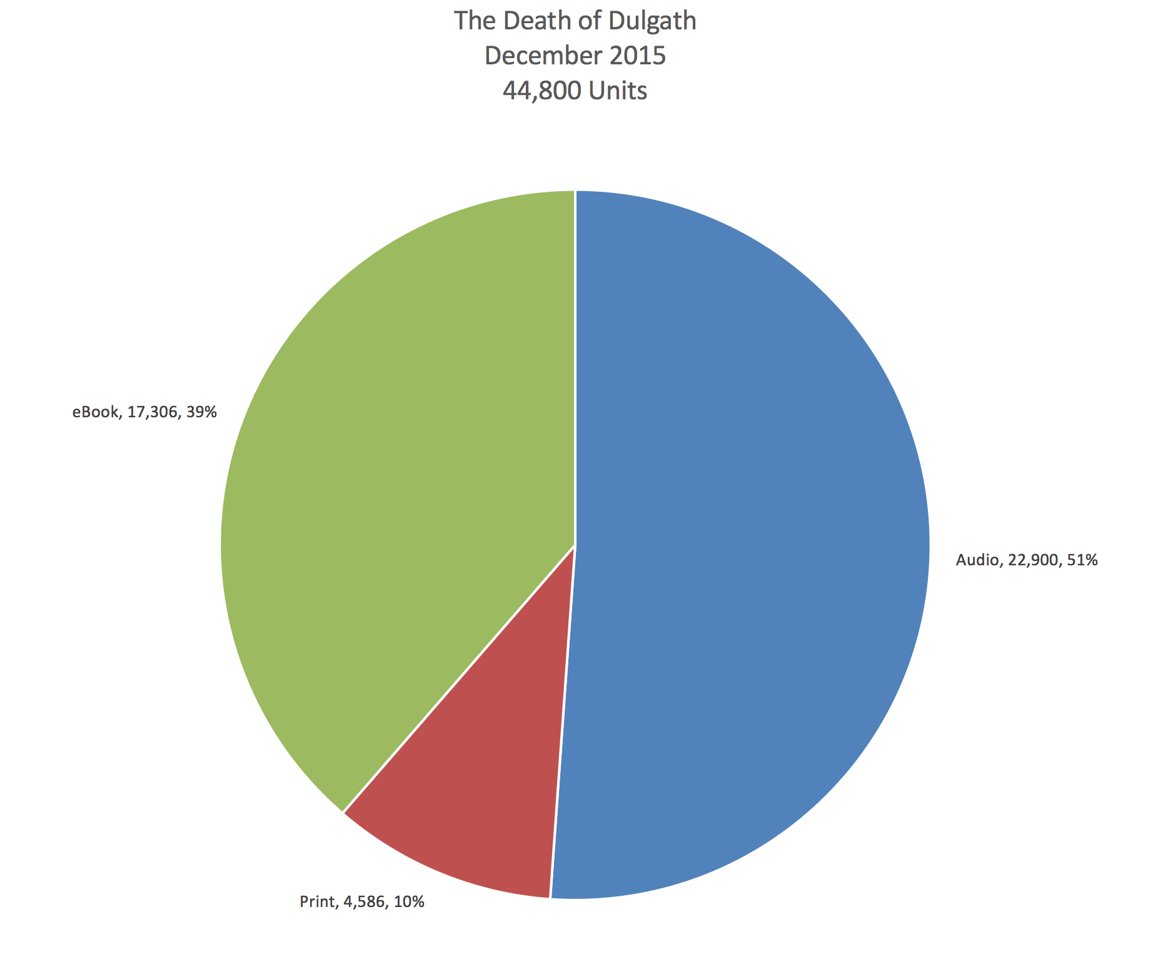
Formats: Self-published

Slide 10
Types of Audio Productions
Abridged
Unabridged
Single Narrator
Multi-cast
Full-cast Dramatization (sound effects & music)
Generally these are a separate right and also affected by media contracts (movie & television)

Slide 11
Whispersync Technology
Buy ebook, get audio book at deep discount
Usually $1.99 - $4.95
Audio and ebook stay synchronized, stop reading/listening on one, and when you pick up the other you are at the place you left off.
Recording and ebook have to match 100% to enable this technology
Not all audiobooks use Whispersync
New integration with Alexa allows you to pickup where you left off by vocal commands.

Slide 12
Content Issues to consider
Excessive dialog tags can be really distracting in audio recordings
John Scalzi changed his writing style)
Extremely important internal direct thought (which shows in italics in books) may need and attribution to show it wasn’t said out loud). Also, narrators can also modify their voice slightly.
I really hate this guy, Hadrian thought.

Slide 13
Audio Book Distribution
Audible.com – the “Amazon” of audiobook content (7 countries - by far the highest income potential
Libraries – Recorded Books dominates this market
Bookstores – no longer a major revenue source
Scribd – added audio downloads to their Netflix model
Audiobooks.com – minor player (recently bought by Recorded Books)
Findaway Voices – new player trying to compete with ACX from the founders of Draft2Digital – touting lower production costs

Slide 14
Audio book Producers
Publishers: Random House Audio | Hachette Audio, Simon & Schuster | Macmillan Audio | Penguin Audio | Harper Audio
Amazon: Audible Studios| Brilliance | ACX
Independents: Recorded Books | Podium Publishing | Open Book | Blackstone Audio
ACX – self-publishing
Graphic Audio – full cast dramatized

Slide 15
Publishing Options
Traditional
Sell rights to print/ebook publisher
Produce themselves
Sell as an audio right
Sell rights to an audio producer (non-exclusive)
Sell rights to Audible directly (exclusive)
Self-publishing
ACX
Exclusive producer – must pay for production costs
Exclusive with producer partner – split royalty
Non-exclusive – must pay for production costs
Podiobooks.com
Mainly authors self-recording and posting
Pay what you want model (most don’t donate)

Slide 16
Traditional Publishing
Rights grab – print/ebook/audio
May not pay additional advance for inclusion of audio rights
Many publishers now requiring audio rights.
In house production becoming more common for higher % of income – author gets 25% of net just like audio rights
Subsidiary right – selling rights to Recorded Books
Generally speaking, author has no say over production, advance, or partner the rights are sold to
Income is split 50%/50% with publisher for nothing more than singing a piece of paper.

Slide 17
Self Publishing – not as easy as ebooks
Expensive
Narrators, studio time, engineer, post-production mastering
Time consuming
Find narrators
Listen to samples
Broker a deal
Find a studio
Oversee recording and/or editing

Slide 18
Self-publishing Production
Expenses:
Audio narrators
Unionized (SAG-AFTRA) and health & benefits fund)
$100 – $200 an experienced narrator
$200 - $300 an hour + 12% for top talent
Studio time (Some are better than others)
Brick Box: $100 hour
With an Engineer: $200 hour
Full production with mastering: $300
Post-production fees (mastering, leveling, compressing)
Editing $100 hour (2x final production time)
Could easily run $350 - $600 per recorded hour
Age of Myth (432 pages): 17 hours = $5,950 - $10,200

Slide 19
Audiobook Deals
Riyria Revelations
$2,000/book = $6,000 (Subsidiary w/Recorded Books)
Riyria Chronicles
Book 1-2: $5,500/book = $11,000 (Subsidiary w/Recorded Books)
Book 3: Audible Studios $75,000
Book 4: Audible Studios $100,000
Hollow World
Recorded Books: $8,000
Legends of the First Empire
Book 1 – 4: Recorded books: $35,000/book = $140,000
Book 5: Audible Studios $75,000
Book 6: Audible Studios $90,000
Bridge Series
Book 1 -3: Audible Studios, $1,000,000

Slide 20
Traditional Royalties
Publishers (Hachette Audio)
With their house: 25% of net
As a subsidiary: 50% of net from
Audio producers (Recorded Books)
20% - 25% of net to author
Audible.com shares (partners % not verified)
Direct to author: 15%
With partners: 35%

Slide 21
Self-publishing Royalty
ACX – source to find production companies and narrators
Exclusive to Audible and Apple
Exclusive: 60% Audible | 40% producer
Exclusive: 60% Audible | 20% rights holder | 20% producer
Nonexclusive: 75% Audible | 25% producer

Slide 22
Income for Audio Versions
$10 income to Audible
ACX as publisher: $4.00
ACX with partner: $2.00
Audible Published: $1.50
Recorded Books: 20% of 35% = $0.70
Produced by Publisher’s Studio: 25% of 35% = $0.88
Sold as Subsidiary Right: 50% of 20% of 35% = $0.35

Slide 23
Income per Book (before splits)
Riyria Revelations (Recorded Books)
$8.50 – $11.50 normal | $4.50 - $4.77 on special
Riyria Chronicles (Recorded Books)
$6.00 – $6.50 normal | $3.00 - $3.25 on special
Riyria Chronicles (Audible Studios)
$13.00 - $14.00

Slide 24
Income Breakdown

Slide 25
Questions
Write me at michael.sullivan.dc@gmail.com

